Slide 1
Defect Prevention

Slide 2
Objectives
  At the end of this module, you will be able to:
  Explain why testing must start early in the software development life cycle
  Describe Defect insertion and detection points
  Explain Defect Prevention
  List the principles of Defect Prevention
  State Defect Prevention Activities
  Explain Defect Detection
  Describe Defect Correction
  Describe Defect Removal Efficiency
  List the benefits of Defect Prevention

Slide 3

Introduction
  Defects, are variances from a desired attribute.
  These attributes include complete and correct requirements and specifications as drawn from the desires of potential customers.
  Defect Prevention has a direct impact on controlling the cost of the project and the quality of deliverables.
  Cost of rectifying defect in the product is very high when compared to preventing.
  Hence it is always advisable to take measures, to prevent the defect being introduced in the product, as early as possible. The end result will be a product with zero or minimal defects.

Slide 4
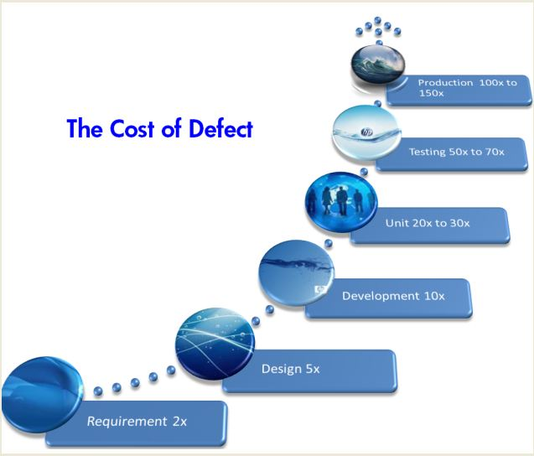
Relative Cost of defects

Slide 5
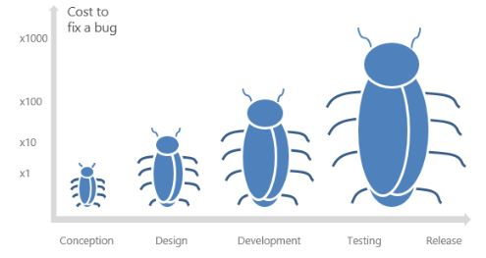
Why testing should start early in the software development life cycle?
For instance, a bug identified during conception costs something around zero, but when this same bug is found only after implementation or test, the average cost of repair can get to something between 10 and 1000 times more than in the previous step.
When customers find this bug in the production environment, the cost of the problem considers all side effects related to it and that is where things can get serious.

Slide 6
Advantages of testing in earlier phases
Many problems are introduced into the system during planning or design. Requirements testing anticipate future problems at a significantly lower cost.
Since the testing process is involved with all phases of the SDLC, Management will not feel like testing is the bottleneck to release the product.
Testers will be more familiar with the software, as they are more involved with the evolution of the product in earlier phases.
Test cases written during requirements and shared with the Dev team before the construction phase can help developers to think outside the box and evaluate more chances of failure in their code.
The test environment can be prepared in advance, anticipating risks and preventing delays.
The risk of having a short time for testing is greatly reduced, increasing test coverage and types of tests performed.
Involving quality assurance in all phases of the SDLC helps creating a ‘quality culture’ inside the organization.

Slide 7
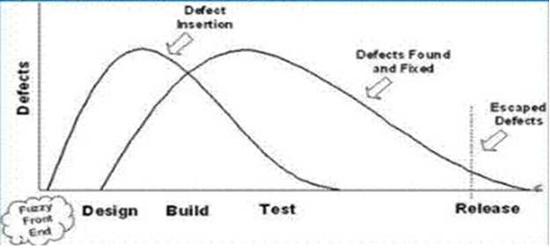
Defect insertion and detection points
Defects are introduced into a system at a number of points during the software development lifecycle. The following chart is a model of a typical development lifecycle that illustrates the usual points of defect insertion and detection. The left-most line here shows at which points in the project lifecycle the defects are introduced. The second line illustrates the traditional points at which defects are detected and removed.

Slide 8
Defect insertion and detection points
A project should aim to push these two lines together as much as possible. One way of doing this is to treat the requirements and design documentation to a structured formal review and testing process early on in the project lifecycle.
This will reduce defects occurring related to ambiguous, unverifiable, contradictory or incomplete requirements before they have even been committed to code.
Signed-off business requirements that are clear, unambiguous and have measurable, testable acceptance criteria are much more likely to be developed to reflect the business intent.
Market research indicates that 30% of a project budget is consumed by rework activities, meaning those things that should have been done or communicated properly the first time.
Research also indicates that of that rework, 70% is related to the requirements. In other words, 21% of the project budget is spent on correcting and removing defects originating in the requirements and design documents.

Slide 9
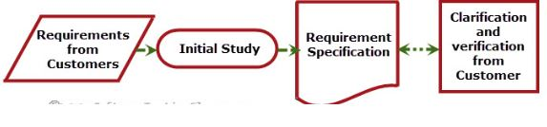
Defect Prevention
In the Defect prevention phase, testers are involved in studying and reviewing the requirement specification document.
While studying this document, testers run into different queries and misleading or unclear requirements. So, based on queries raised by the team, stakeholders provide inputs and provide the changed/updated requirement specification document.
The developer is involved in activities like reviewing requirement, code review, static code analysis, unit testing etc. Developers often ignore the uncertainty/ambiguity in specification documents as they want to finish the coding.
When testers find these ambiguities upfront in the requirement specification review phase, the cost of fixing such defects is smallest. It is advisable to make measures that prevent the defect from being introduced in the product right from early stages of the project.

Slide 10
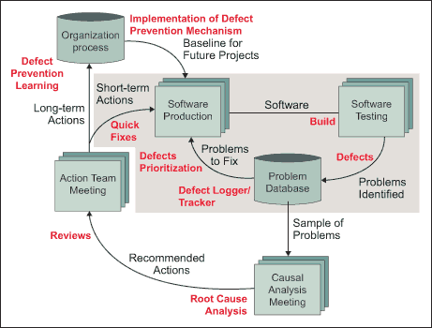
Principles of Defect Prevention
  Defect Prevention Cycle (Source: 1998 IEEE Software Productivity Consortium)

Slide 11
Principles of Defect Prevention
The defect prevention process begins with requirement analysis – translating the customer requirements into product specifications without introducing additional errors.
The blocks and processes in the grey-colored block represent the handling of defects within the existing philosophy of most of the software industry – defect detection, tracking/documenting and analysis of defects for arriving at quick, short-term solutions.
The processes that form the integral part of the defect prevention methodology are on the white background. The vital process of the defect prevention methodology is to analyse defects to get their root causes, to determine a quick solution and preventive action.
Most of the activities of the defect prevention methodology require a facilitator. The facilitator can be the software development project leader or any member of the team.
The designated defect prevention coordinator is actively involved in leading defect prevention efforts, facilitating meetings and communication among team and management, and consolidating the defect prevention measures/guidelines.

Slide 12
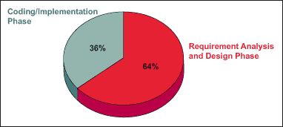
Defect Prevention Activities
Software Requirements Analysis
Errors in software requirements and software design documents are more frequent than errors in the source code itself. Defects introduced during the requirements and design phase are not only more probable but also are more severe and more difficult to remove. Front-end errors in requirements and design cannot be found and removed via testing, but instead need pre-test reviews and inspections.
It is important to have a proper process of analyzing the requirements in place to ensure that the customer needs are correctly translated into product specifications. Perhaps two or three iteration of interactive sessions with the customer can be of great help in verifying the understanding of the developer about actual requirements.
Deviation of Defects Introduced into Software by Phase
Software Development Phases | Percent of Defects Introduced
Requirements | 20 Percent
Design | 25 Percent
Coding | 35 Percent
User Manuals | 12 Percent
Bad Fixes | 8 Percent

Slide 13
Defect Prevention Activities
Reviews: Self-Review and Peer Review
Self-review is one of the most effective activities in uncovering the defects which may later be discovered by a testing team or directly by a customer. The majority of the software organizations are now making this a part of “coding best practices” and are really increasing their product quality.
Often, a self-review of the code helps reduce the defects related to algorithm implementations, incorrect logic or certain missing conditions. Once the developer feels they are ready with the module code, a glance through the code and understanding what it does compared to what it is supposed to do, would complete the self-review.
Peer review is similar to self-review in terms of the objective – the only difference is that it is a peer (someone who understands the functionality of the code very well) who reviews the code. The advantage is that of a “fresh pair of eyes.”

Slide 14
Inspection and Review
The main objective of an Inspection or a Review is to detect defects.
This activity and procedure was first formalised by Mike Fagan of IBM during a period when CPU was still much more costly than people, and system complexity increased to the point where software quality became a huge issue.
Inspections and reviews are testing of software artifacts without the actual execution of code and is especially suited for :
    Requirements - documents
    Design - documents
    Plans and Tests Cases – documents
    Customer education material - documents

Slide 15
Inspection as Natural Part of Software Development
Requirements
Analysis
Inspect
Document
most often used
Design
Inspect
Document
less often used
Code &
Manuals
Inspect
Code & doc.
Inspect
Test Cases
Functional Test
Inspect
Test Cases
least often used
Component
Test
Inspect
Test Cases
System Test

Slide 16
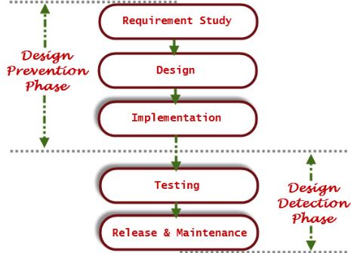
Defect Detection
The diagram on the slide shows the process steps involved in the Design Prevention Phase and Detection phase:
Defect Detection: The testing process or strategy for defect detection should be defined well in advance, so that the testing activity can be carried out very smoothly like functional testing, System testing, Regression testing, Exploratory testing etc. Tester should have complete understanding /knowledge of application under test, which will help to increase the defect detection rate.
Defect Detection Efficiency: Defect Detection Efficiency (DDE) is the number of defects injected and detected in a phase by the total number of defects injected in that phase.
Defect Detection Efficiency (DDE) = (Number of Defects Injected AND Detected in a Phase / Total Number of Defects Injected in that Phase) x 100 %
Defect Detection Efficiency Formula

Slide 17
Defect Correction Activities
Corrective Action is a future response to the defect repair process or the correction, so that the cause of error or non-conformity will not occur again.
For example: during the inspection, you found some defective component, and you corrected the defective component. Now, you don’t want this defect to happen again. Therefore, you will look into the root cause of the problem, find a solution, and apply it to your operations so that the defects do not occur again.
In other words, the Corrective Actions are the steps taken to correct the root problem and stop the recurrence of deviation.
Corrective Action is a reactive process and it is performed to bring the deviation under control.
  Defect Logging and Documentation
  Effective defect tracking begins with a systematic process. A structured tracking process begins with initially logging the defects, investigating the defects, then providing the structure to resolve them. Defect analysis and reporting offer a powerful means to manage defects and defect depletion trends, hence, costs.

Slide 18
Defect Correction Activities
Root Cause Analysis and Preventive Measures Determination
  After defects are logged and documented, the next step is to analyse them. Generally, the designated defect prevention coordinator or development project leader facilitates a meeting to explore root causes.
  The root cause analysis of a defect is driven by three key principles:
  Reducing the defects to improve the quality: The analysis should lead to implementing changes in processes that help prevent defects and ensure their early detection.
  Applying local expertise: The people who really understand what went wrong are the people present when the defects were inserted – members of the software engineering team. They can give the best suggestions for how to avoid such defects in the future.
  Targeting the systematic errors: There may be many errors or defects to be handled in such an analysis forum; however, some mistakes tend to be repeated. These systematic errors account for a large portion of the defects found in the typical software project.
  With these guidelines, defects are analysed to determine their origins. A collection of such causes will help in doing the root cause analysis. The defects are classified based on their types. A Pareto chart is prepared to show the defect category with the highest frequency of occurrence – the target

Slide 19
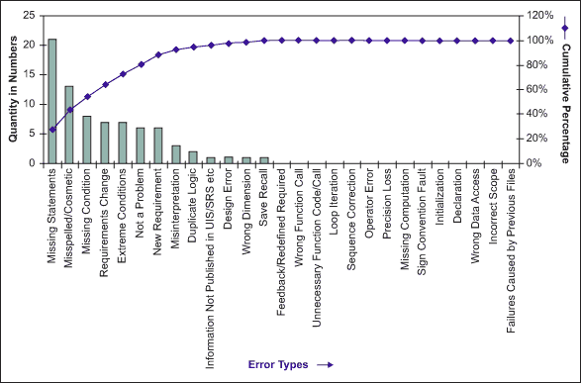
Defect Correction Activities
Example of Defect Classification in a Pareto Chart

Slide 20
Defect Correction – Root Cause Analysis
This is a structured approach to identifying the factors (causes) of problems; then follow-up with “addressing” and “fixing” these potential causes.
One popular graphical tool used is the “cause-and- effect” diagram (developed by Ishikawa to study factors that affected the production of steel), which looks like a fishbone:
  Place the problem at the right tip
  Place the causes on the branches (out like a fish bone)

Slide 21
Defect Correction Activities
  Root Cause Analysis and Preventive Measures Determination
  Root cause analysis is the process of finding and eliminating the cause, which would prevent the problem from recurring. Finding the causes and eliminating them are equally important.
  Each defect category and the causes making those defects happen can be represented using a cause-and-effect diagram
  The cause-and-effect diagram, also known as a fishbone diagram, is a simple graphical technique for sorting and relating factors that contribute to a given situation. A team usually develops the cause-and-effect diagram in a facilitated brainstorming session. Once the root causes are documented, finding ways to eliminate them requires another round of brainstorming. The objective is to determine what changes must be incorporated in the processes so that recurrence of the defects can be minimised.

Slide 22
Cause-and-Effect Diagram( for error prevention )
Tight Scheduling
Poor Tools
No version
control
Market
pressure
Poor
estimation
skill
No-debugger
Programming
Problems
Hiring problem
Lack of
training
Poor Programmers
Hard parts are:
Clear problem def.
Coming up with the potential “causes”

Slide 23
Cause-and-Effect Diagram (a more “specific” example)
wrong state
wrong input data
No “undo”
state
No input
checking
Program terminates
unexpectedly after input
numerical
overflow
divide by
zero
error in
computation

Slide 24
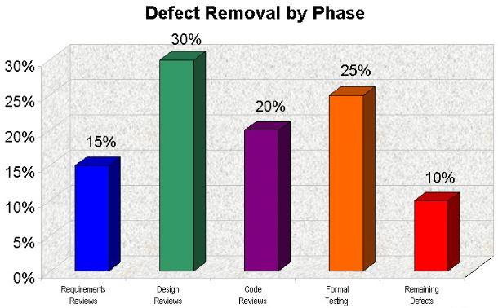
Defect Removal Efficiency
If an organization has no defect prevention methods in place, then they are totally reliant on defect removal efficiency.
Requirements Reviews up to 15% removal of potential defects
Design Reviews up to 30% removal of potential defects
Code Reviews up to 20% removal of potential defects
Formal Testing up to 25% removal of potential defects

Slide 25
Defect Removal Efficiency
In other words, if an organization is great at defect removal the maximum percentage of defects an organization can expect to remove is 90%. If a software project is 100 function points, the total number of maximum (or potential) defects could be 120. If you were perfect at defect removal, your project would still have up to 12 defects after all your defect discovery and removal efforts. The far majority of organizations would receive a B (medium) or even a D (poor) at defect removal efficiency.
Activity | Perfect | Medium | Poor
Requirement Review | 15% | 5% | 0%
Design Reviews | 30% | 15% | 0%
Code Reviews | 20% | 10% | 0%
Formal Testing | 25% | 15% | 15%
Total Percentage Removed | 90% | 45% | 15%

Slide 26
Benefits of Defect Prevention Process
The benefits of implementing a defect prevention methodology are:
  Reduced rework effort/development time
  Significant reduction in the number of defects and their severity
  Time and Cost savings
  Enhanced total productivity
  Increased customer satisfaction

Slide 27
Summary
  In this module, you learnt about:
  Why testing must start early in the software development life cycle
  Defect insertion and detection points
  Defect Prevention
  The principles of Defect Prevention
  Defect Prevention Activities
  Defect Detection
  Defect Correction
  Defect Removal Efficiency
  The benefits of Defect Prevention

